Slide 1
NEXTHIKES IT SOLUTIONS
PROJECT- NLP Project for Disaster Tweet Classification
BY- SAKSHI JAISWAL

Slide 2
OVERVIEW
ROWS- 7613
COLUMNS- 5
FEATURES- id, keyword, location, text, target
TARGET VARIABLE
0 = Non- Disaster
1 = Disaster

Slide 3
DATA UNDERSTANDING AND MISSING VALUES
Keyword and location contain missing values.
Text and target have no missing values.
Missing values do not significantly affect classification.

Slide 4
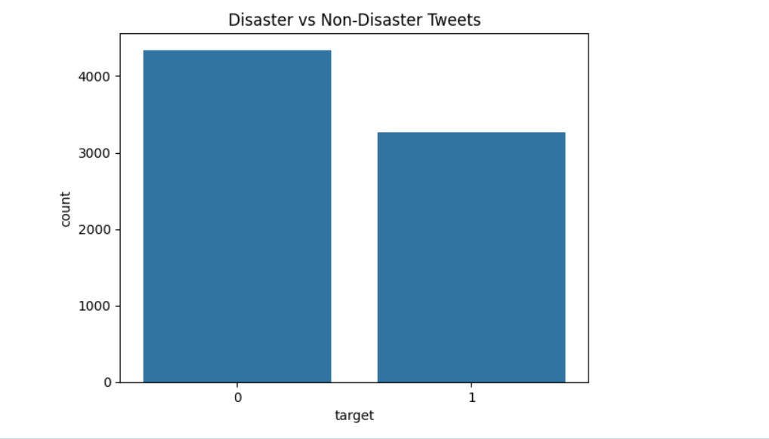
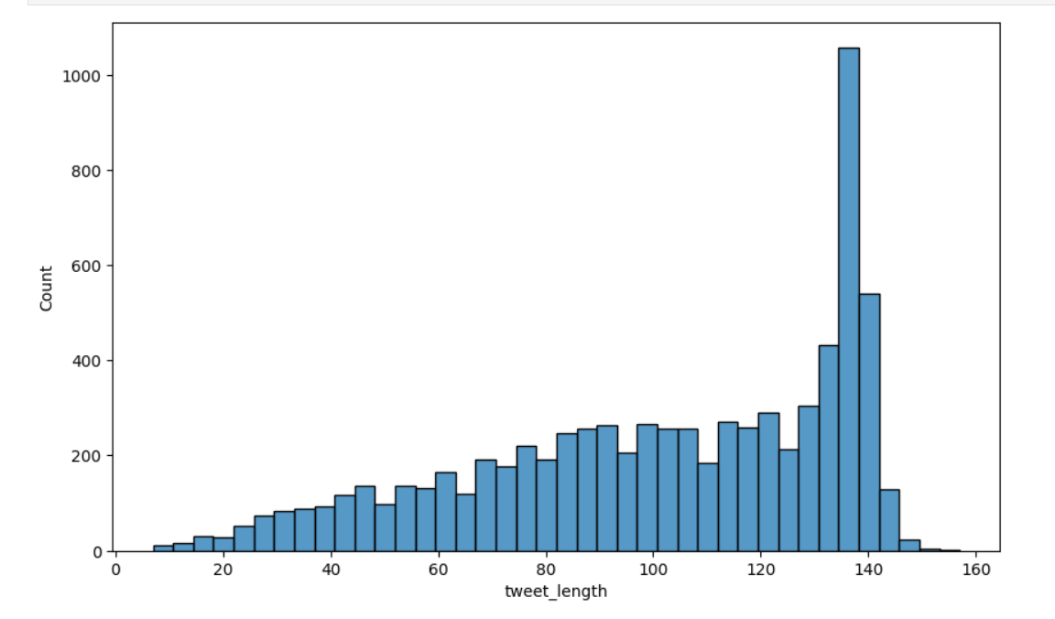
EXPLORATORY DATA ANALYSIS (EDA)

Slide 5
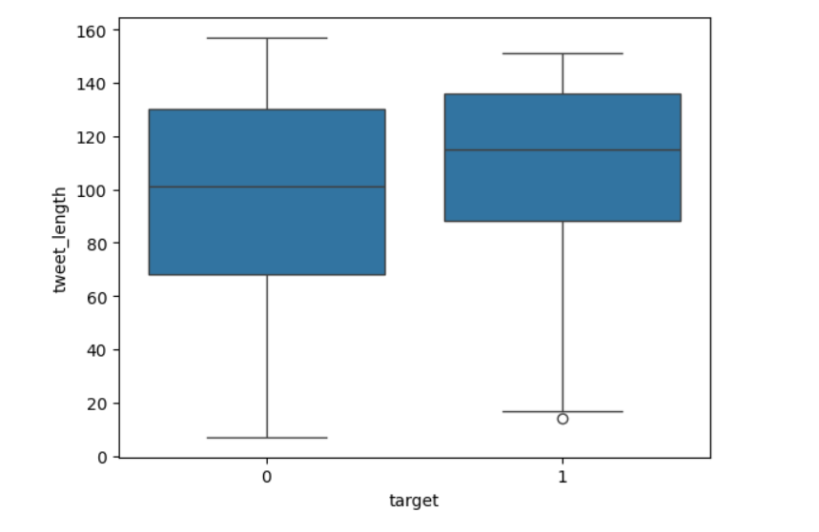

Slide 6
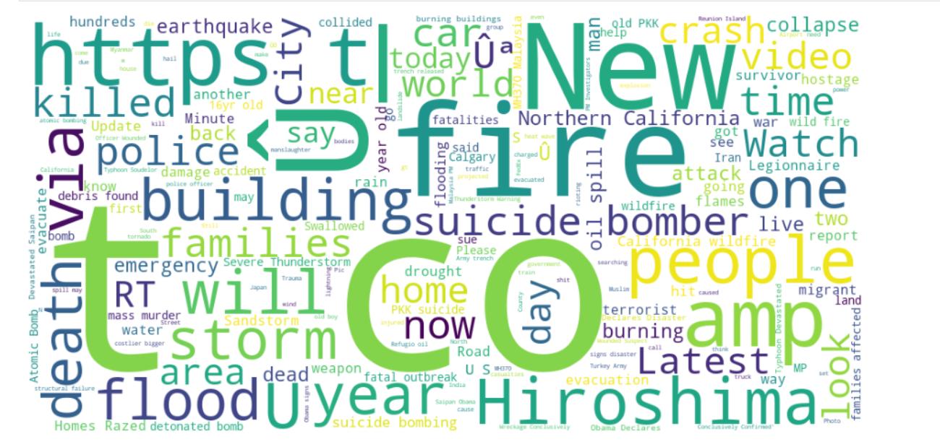
TEXT ANALYSIS
WORD CLOUD OF DISASTER TWEETS
Disaster tweets frequently contain words like – fire, flood, emergency,explosion etc.

Slide 7
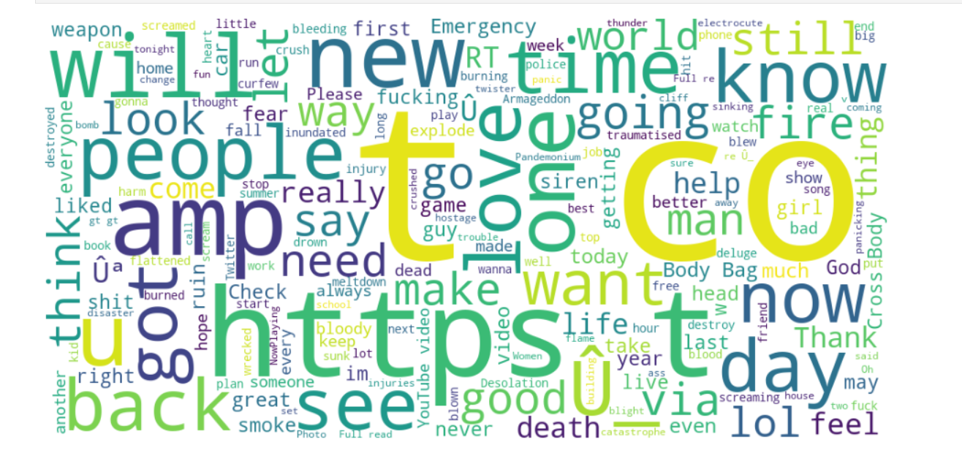
WORD CLOUD OF NON- DISASTER TWEETS
Non-disaster tweets contain casual words such as: love, happy, cool etc.

Slide 8
DATA PREPROCESSING
Raw Tweets
↓
Text Cleaning
↓
Lowercasing
↓
Remove URLs
↓
Remove Punctuation
↓
Tokenization
↓
TF-IDF Vectorization

Slide 9
FEATURE ENGINEERING
TF-IDF Vectorization because-
Converts text into numerical features.
Gives higher importance to informative words.
Reduces influence of common words.

Slide 10
Machine Learning Models Used
Model | Purpose
Logistic Regression | Baseline model
Naive Bayes | Text classification
Random Forest | Ensemble learning
Linear SVM | High-dimensional text data

Slide 11
MODEL COMPARISON
MODEL ACCURACY
Logistic regression 0.819435
Naïve bayes 0.814183
Random forest 0.784636
SVM 0.788575

Slide 12
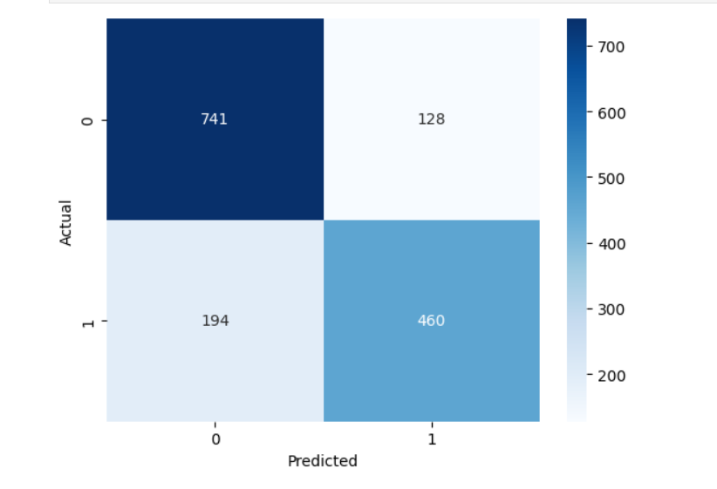
CONFUSION MATRIX
The model correctly classified most tweets and demonstrated good generalization.

Slide 13
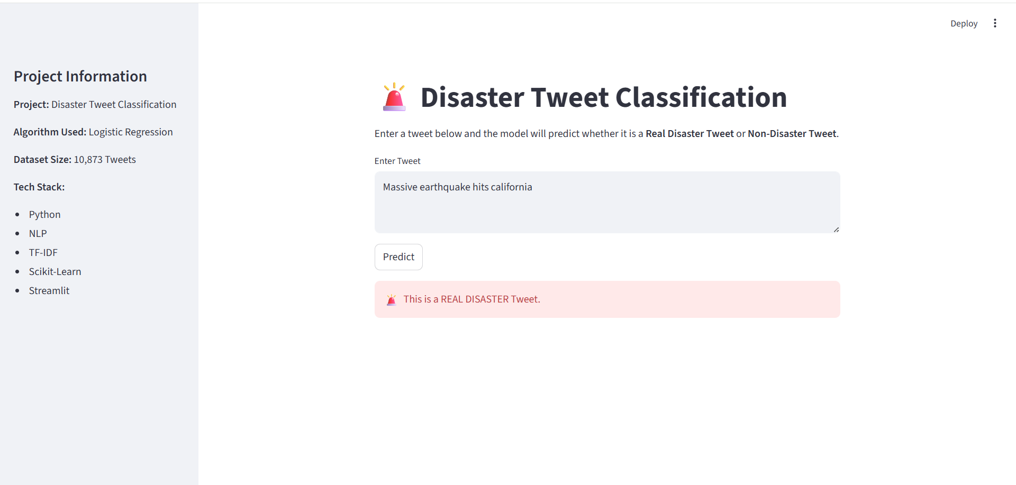
STREAMLIT WEB APPLICATION

Slide 14
THANK YOU

